Slide 1
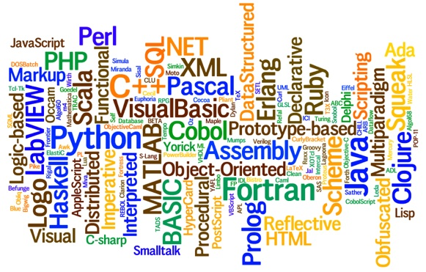
CS-445 Programming Languages Slides 1 – Why to Study Programming Languages
By Talha Waheed, Dept. of CS, UET, Lahore

Slide 2
Welcome to Programming Languages Landscape
Introduction
Course Learning Objectives
Concepts to Cover
Today’s Learning Objectives
Notes:
Who Am I
Introduction of Course
This Course is About
Languages

Slide 3
(Text Book)
Robert W. Sebesta , Concepts of Programming Languages (12th Ed, or 11th International Ed.), Pearson 2019.
(Reference Books)
Tucker and Noonan, Programming Languages: Principles and Paradigms, 2nd edition, MsGraw Hill, 2006
Gabbriell and Matini, Programming Languages: Principles and Paradigms, Springer, 2010
Michael L. Scott , Programming Language Pragmatics, 3rd Ed, Morgan Kaufman 2009.
Pratt and Zelkowitz, Programming Languages: Design and Implementation, 4th edition, Prentice Hall, 2001.
Wilson and Clark, Comparative Programming Languages. 3r^{d} Ed. Addison Wesley
Salus, Hand Book of Programming Languages (Vol I to IV).

Slide 4
What is a Programming Language?
Non Technical Definition
A Programming language is a way of communicating with the computer to tell it what it should do.
Some Technical Definitions
Notation for description of Algorithm and Data Structures.
A notational system for describing computation In machine-readable and Human-readable form
It is a “notation ... used for specifying, organizing, and reasoning about computations.”
Notes:
``Programming languages were invented to make machines easier to use. They thrive because they make problems easier to solve.''

Slide 5
This (Meta-level) Course Is
About
Languages
Their properties
What, how and why?
Their historical Context
Design Issues and choices
Principles
Practical and formal
Not restricted to a single language
Comparing Paradigms
Representative Languages like Lisp, Prolog
Not about
Programming
In particular, not the place to learn basics of programming.
Applications
In particular, not the place to learn about guis, applets etc.

Slide 6
Questions to be Answered
Why are there so many different programming languages?
How and why they are developed?
What is the intended purpose of a language?
In what ways are they similar?
What are the differences among them?
Why wouldn’t we simply continue to use what we have today?
What kinds of programming languages may be developed in future?

Slide 7
Why Study Programming Languages?
Better use of the programming language you are using.
To increase capacity of expressing ideas and developing effective algorithms.
To be able to chose a programming language wisely.
To increase ability to learn new languages and paradigms.
To better understand the significance of implementation issues.
To increase ability to design your own “little languages”.
For the overall advancement of computing.

Slide 8
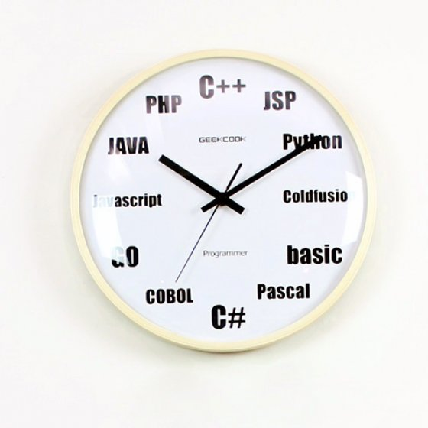
Why are there so many prog. languages?
they try out new ideas
they enforce policies
they provide shorter notation (much of the coding is implicit)
they meet specific needs

Slide 9
Reasons to study concepts of Programming Languages
Increased capacity to express programming concepts
Improved background for choosing appropriate languages
Increased ability to learn new languages
Design methodologies
Understanding the significance of implementation
Increased ability to design new languages

Slide 10
Increased Capacity to express programming concepts
The tools we use have a profound (and devious!) influence on our thinking habits, and, therefore, on our thinking abilities. (Dijkstra)
Depth at which we can think is influenced by the expressive power of the language (Sapir – Wharf Hypothesis)
What kind of algorithms can you develop?
Can increase the range of software development thought process by learning new languages.
Those constructs can be simulated

Slide 11
Improved background for Choosing appropriate languages
"To the man who only has a hammer in the toolkit, every problem looks like a nail."
Abraham Maslow
Sometimes, some programming languages are more suitable for a specific task.
Special purpose languages: Snobol

Slide 12
Better understanding of significance of implementation
In some cases, an understanding of implementation issues leads to an understanding of why languages are designed the way they are.
Leads to efficient use of the language e.g.
Row vs. column major array
Support for recursion
Certain bugs can only be found and fixed if the programmer knows some related implementation details.

Slide 13
Major Application Domains
Scientific applications
Simple data structures, large FP operations – FORTRAN
Busines applicatoins
Reports, deciaml arithmetic – COBOL
Artifical Intelligence
Symbol Processing (Lisp), logic programming (Prolog).
System Programming
Execution efficiency, low-level features – PL/1, BLISS, C
Scripting languages
List of commands – batch files, Perl
Special purpose languages
Snobol
Parallel/Distributed Computing
Real Time Systems
Data Science and Machine Learning
Python, R

Slide 14
Different Perspectives on PL Study
Formal - abstract properties of symbolic systems
Engineering - implementation & performance
Software Engineering - features and their impact on development, maintenance, correctness
Historical - evolution of languages and features
(ALL VALUABLE, NONE SUFFICIENT)

